Slide 1

Develop Speedometer using Hall Effect Sensor and C++
Designing a speedometer using a Hall Effect sensor and C++, this project combines hardware and software to create a digital speed measurement system for vehicles.
BY
P.NAVYA SRI(192210714)
P.MANOHAR(192210723)

Slide 2
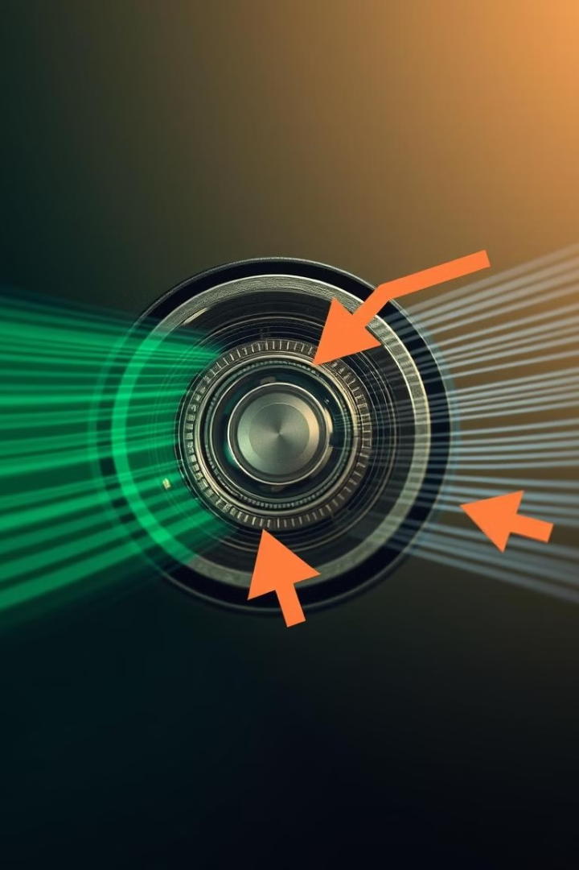
Introduction to Hall Effect Sensor
1
Magnetic Field Detection
2
Versatile Applications
These sensors are widely used in speed, position, and current detection applications.
Hall Effect sensors measure the strength of a magnetic field, converting it into an electrical signal.
3
Compact Design
Hall Effect sensors are small, solid-state devices with no moving parts, making them durable and reliable.

Slide 3
Principles of Hall Effect Sensor
Magnetic Field
Electron Deflection
Sensor Output
When a magnetic field is applied perpendicular to the current flow, it generates a voltage potential.
The magnetic field causes the electrons to deflect, creating the Hall voltage, which is proportional to the magnetic field strength.
The Hall Effect sensor converts the magnetic field changes into an electrical output signal that can be measured and processed.

Slide 4
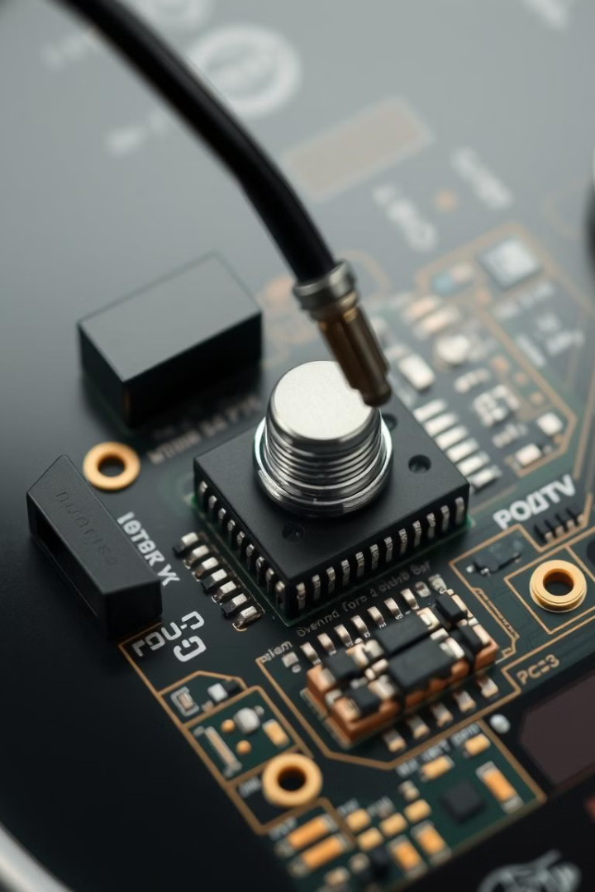
Hardware Components
Hall Effect Sensor
Microcontroller
Detects the passing of a magnet or ferromagnetic material, generating electrical pulses.
Processes the sensor inputs, calculates the speed, and displays the information on a digital gauge.
Power Supply
Digital Gauge
Provides the necessary voltage and current to power the Hall Effect sensor and microcontroller.
Displays the calculated speed in a clear and easily readable format for the user.

Slide 5
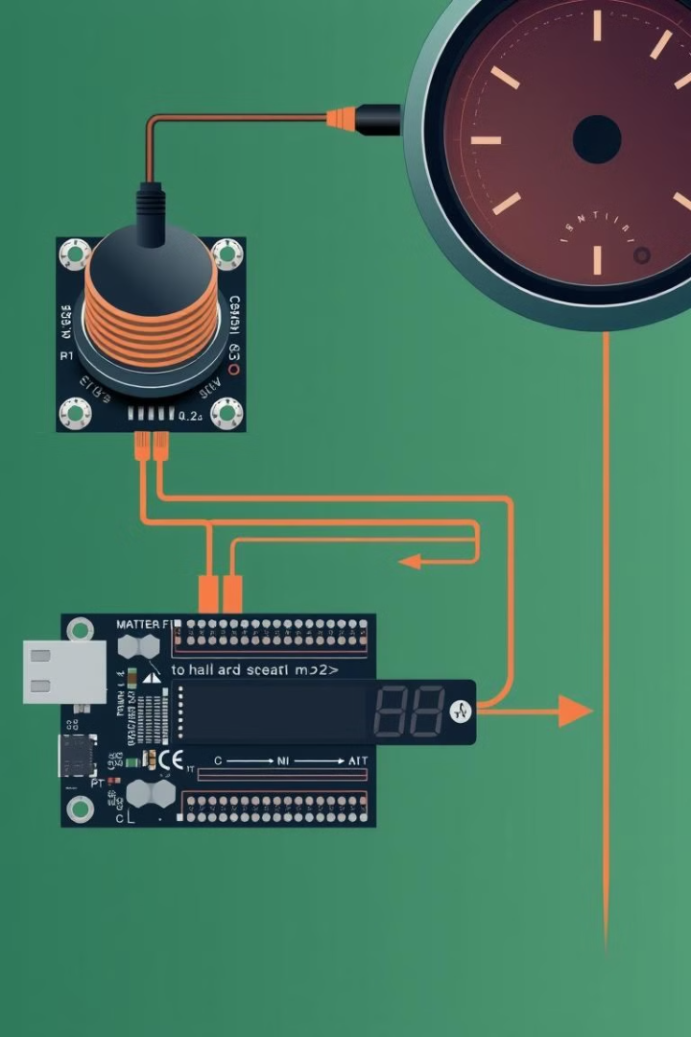



Circuit Design and Connections
Hall Effect Sensor
Detects the magnetic field changes as the wheel rotates.
Microcontroller
Processes the sensor signals and calculates the vehicle speed.
Digital Gauge
Displays the calculated speed in real-time.

Slide 6
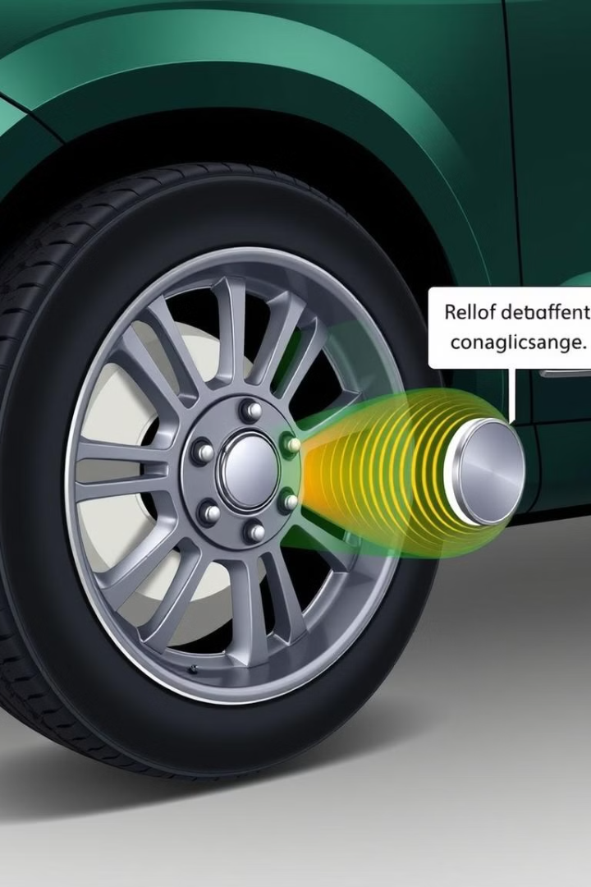
Measuring Wheel Rotations
1
Magnet Attachment
A small permanent magnet is attached to the vehicle's wheel.
2
Sensor Placement
The Hall Effect sensor is positioned near the wheel to detect the passing of the magnet.
3
Pulse Generation
As the wheel rotates, the sensor generates electrical pulses, indicating the number of wheel revolutions.

Slide 7
Converting Rotations to Speed
Pulse Counting
Speed Calculation
Real-time Update
The microcontroller counts the number of pulses generated by the Hall Effect sensor over a specific time interval.
Using the wheel circumference and the pulse count, the microcontroller calculates the current vehicle speed.
The calculated speed is continuously updated and displayed on the digital gauge in real-time.

Slide 8
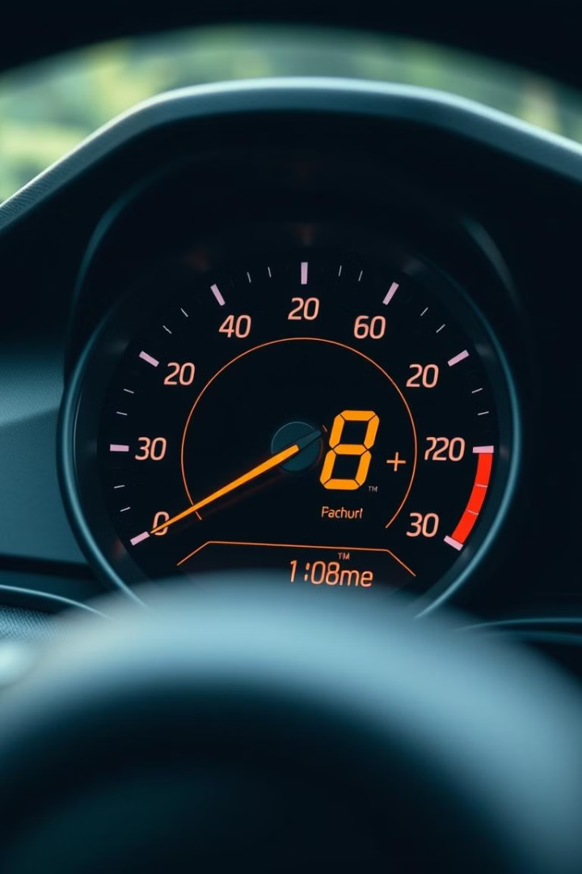



Displaying Speed on a Digital Gauge
Speed Readout
The calculated speed is displayed on a digital gauge with large, easy-to-read numbers.
Vehicle Integration
The speedometer can be seamlessly integrated into the vehicle's dashboard for a clean, professional look.
Microcontroller Control
The microcontroller manages the sensor input, speed calculation, and display update.

Slide 9
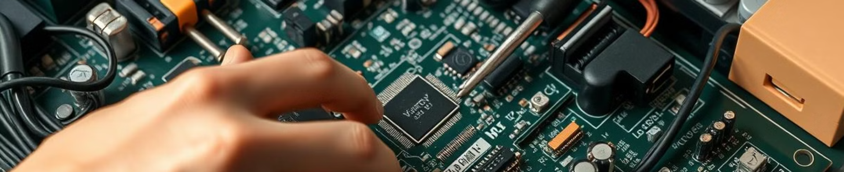
Conclusion and Next Steps
1
Project Summary
2
Future Enhancements
3
Learning Opportunities
This project demonstrates the use of a Hall Effect sensor and C++ programming to create a functional digital speedometer.
Potential improvements include adding features like GPS integration, storage of driving data, and mobile app connectivity.
This project provides valuable experience in hardware-software integration, sensor-based systems, and embedded programming.

